Slide 1

End-of-Life Care in
Residential Care Homes in Hong Kong
Cecilia Chan
Project Director
Hong Kong Association of Gerontology
30 November 2018
香港老年學會
Hong Kong Association of Gerontology

Slide 2
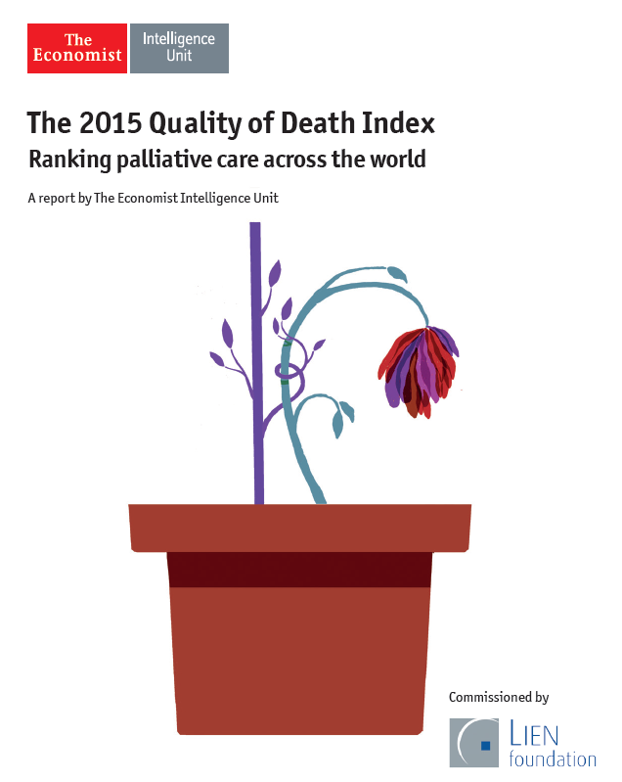
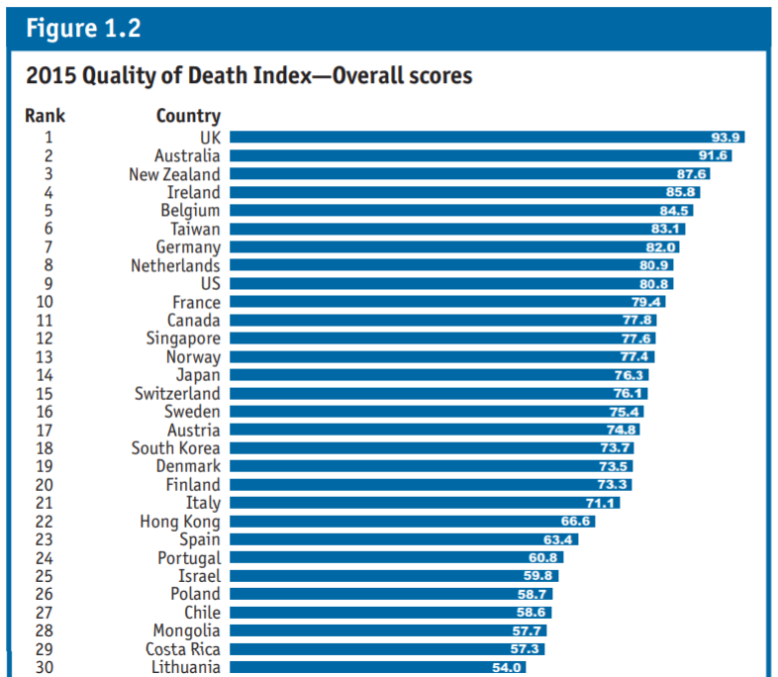
Quality of Death – Hong Kong

Slide 3
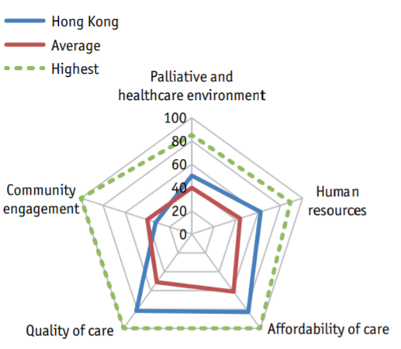
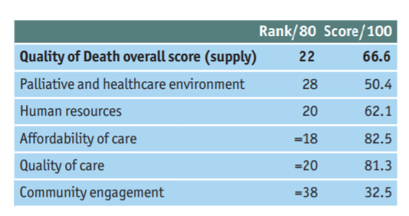
Quality of Death – Hong Kong
Source: The 2015 Quality of Death Index: Country Profiles
A Report by the Economist Intelligence Unit

Slide 4
Rising aging population in Hong Kong
16.53%
19.90%
24.07%
27.43%
29.84%
30.93%
31.80%
Source: Hong Kong Population Projections (2017 – 2066),
Census & Statistics Department, HKSAR

Slide 5
High institutionalization rate of elderly population in HK
 | rate
Hong Kong (2009)# | 6.8%
China (2008)* | 1.0%
Taiwan (2009)# | 2.0%
Japan (2006)# | 3.0%
Singapore (2006)# | 2.3%
# aged 65 or above
*aged 60 and above
Source: Chui. et al (2009). Elderly Commission’s Study on Residential Care Services for the Elderly - Final Report

Slide 6
Institutionalization of death
“ The current reality, however, is that most people die in hospitals.
In 2014, there were close to 46,000 registered deaths in Hong Kong, of which about 90% presented to Hospital Authority facilities.”
Source: Chief Executive’s Speech
Hospital Authority Convention 2016

Slide 7
RCHE residents accounts for high % of death in hospital
2014 Hong Kong
46000 deaths
Source: Strategic Service Framework for Palliative Care
Hospital Authority, 2017

Slide 8
Information from 34 RCHEs on residents’ death
Death rate per RCHE per year = ~ 10% to 15%
Age at death | average | 89.2
 | median | 90
 | range | 61 - 109
Stay in RCHE before death | average | 5.8 years
 | median | 4.4 years
 | range | 8 days – 32.3 years

Slide 9
Information from 34 RCHEs on residents’ death
Principal Diagnosis of residents died (Top 4) | Heart Failure/ Congestive Heart Failure | 21.4 %
 | Dementia | 15.4 %
 | Cancer | 12.4 %
 | Stroke | 11.9 %

Slide 10
Demand of End-of-Life Care
For those people who are likely to die within the next 12 months
Include those people whose death is imminent (expected within a few hours or days) and
those with
  Advanced, progressive incurable conditions
  General frailty and co-existing conditions that mean they are expected to die within 12 months
  Existing conditions if they are at risk of dying from a sudden acute crisis in their condition
  Life-threatening acute conditions caused by sudden catastrophic events
Source: General Medical Council, UK, 2010

Slide 11
Demand of End-of-Life Care in Long term care settings
Population aging and rising need of long term care (LTC) raised the concern of end of life care in LTC settings
A significant proportion of older people die in LTC settings, residents have complex trajectories of dying:
  live with non-cancer co-morbidities
  high prevalence of dementia
Source: European Association for Palliative Care -
Report of Palliative Care in Long Term Care Settings for Older People, 2013

Slide 12
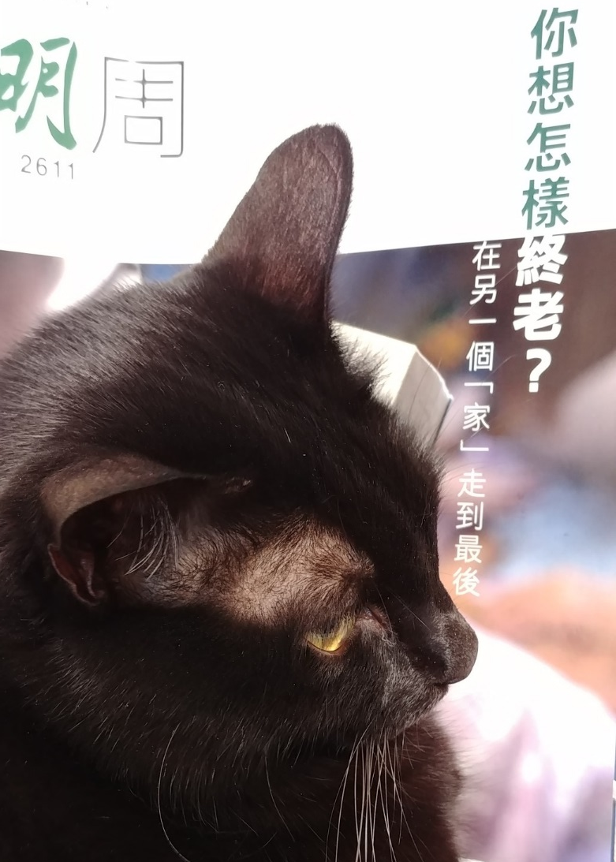
Good Quality of Death
for older people
Is it
achievable in
Residential Care Homes?

Slide 13
Evidence-based palliative approach in Long Term Care Homes
A comprehensive palliative approach education program improves staff confidence to provide a palliative approach for residents and families
A systematic approach to advance care planning provides opportunities for residents wishes regarding care decisions including place of care to be respected
A palliative care case conference means that all health professionals, the residents and family are “on the same page” with regard to palliative care wishes and needs
The use of an end of life care pathway improves the terminal care provided to residents and the family
Source: Tuckett, A. (2010). Comprehensive evidence-based
palliative approach in Residential Aged Care

Slide 14
Is it possible to develop End-of-Life Care in RCHEs?
2007-2009
Hong Kong Association of Gerontology (HKAG) partnered with
International Collaboration for the Care of Elderly (ICCE) &
National Institute in the Care of Elderly (NICE) of Canada
End-of-Life Care Project for Hong Kong and Chinese Communities

Slide 15
End-of-Life Care Project for Hong Kong and Chinese Communities
Survey findings
Most older people feel comfortable to talk about death and support the idea of EOL care
Policy makers, Senior management, RCHE managers are positive in the development of EOL care in Homes
End-of-Life
Care

Slide 16
End-of-Life Care Project for Hong Kong and Chinese Communities
However…….
Home
Space limitation
Insufficient manpower
Staff
Lack of knowledge in EOL care
Culture
Change
Accountability
Unfamiliar care practice

Slide 17
Let’s try to develop End-of-Life Care in RCHEs!
2010-2016
HKAG collaborated with Salvation Army Hong Kong & funded by La Caixa Foundation and Bank of East Asia Foundation
To pilot palliative care service in 6 Residential Care Homes in HK

Slide 18
Palliative care service in Residential Care Homes
Home
Space limitation
Insufficient manpower
Staff
Lack of knowledge in EOL care
Culture
Change
Accountability
Unfamiliar care practice
Enhanced facilities for end-of-life care
EOL Room
Staff training
Knowledge & skill training to all level of staff
Attitude change in staff
Protocol-based model
Case identification and referral
Terminal Care Pathway
Palliative Care Service
Care at final days
Bereavement support to family

Slide 19
Palliative care service in Residential Care Homes
Evaluation on Success Criteria
HOME
Support & commitment
Active participation
CGAT
Medical Social collaboration
TEAM
Nurse & Social Worker
Collaborate with Home staff

Slide 20

Hong Kong Jockey Club Charities Trust
Jockey Club End-of-Life Community Care Project
JCECC: End of Life Care in
Residential Care Homes for the Elderly
2016 - 2018

Slide 21
JCECC: End of Life Care in
Residential Care Homes for the Elderly
2016 - 2018
  To develop a culturally congruent, locally applicable and evidence-based End-of-Life (EOL) care model for improving outcomes in care for the terminal ill elders in RCHEs
  To serve 36 subvented RCHEs on delivering the EOL care services and test out the District-based support model
  To improve the quality of life and quality of death of the frail residents and their relatives in RCHEs

Slide 22
JCECC: End of Life Care in
Residential Care Homes for the Elderly
2016 - 2018
Capacity Building of RCHES in End-of-Life Care
Standardized protocol; EOL Care Room, individualized support during resident’s final days
Medical Social interface – Hospital & CGAT
Promoting choice of care –promote wish and preferences at final days (AD, ACP); die in place
District based EOL care team
Notes:
E.g. key service components, district-based support team, choices of care, etc.

Slide 23
Capacity Building of RCHE
Personal experience in death & loss
Attitude towards death & dying
Training & coaching
EOL care Room & equipment
Standardized protocol
Identification of residents nearing end-of-life
Symptom management
Psycho-social spiritual care
Communication skills
Bereavement counselling skills
Ethical & Legal issues in end-of-life care

Slide 24
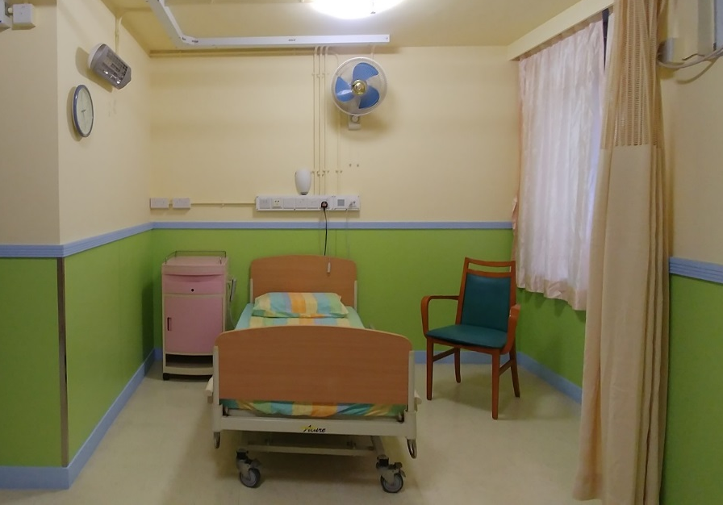
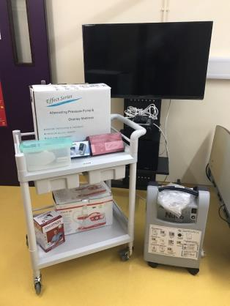
Capacity Building of RCHE
EOL care room & equipment
  For residents during final days
  Comfortable home-like environment for family to accompany residents

Slide 25
Capacity Building of RCHE
Standardized EOL care service protocol
Awareness Building in residents & family
Early identification of residents
Discuss the need for end-of-life care service
Resident and Family EOL care services
Advance Care Planning
Nursing Care support
Psycho-social-spiritual support
Family support
Collaborate with CGAT / Parent teams
Promoting End-of-Life choice & care of residents in final days
Bereavement counselling to family after residents’ death

Slide 26
JCECC: End of Life Care in
Residential Care Homes for the Elderly
2016 - 2018
Service target 1:
Residents with advanced diseases
Cognitively sound
Residents and family willing to discuss advance care planning
Prepare Advance Directive

Slide 27
JCECC: End of Life Care in
Residential Care Homes for the Elderly
2016 - 2018
Service target 2:
Residents for Palliative and End-of-Life care
Limited life expectancy (6 months to 12 months)
Repeated hospitalizations for 3 or more times within recent 6 months due to terminal conditions
On conservative treatment
Resident and family willing to join End-of-Life Care Project

Slide 28
Promoting End-of-Life choice & Care of residents in final days in RCHE
Choice 1: Resident cared in RCHE until expected dying within one to two days; send out to AED
Choice 2: Resident cared in RCHE until the last moment and send out to AED
Choice 3: Resident cared in RCHE until the last moment and certified death by Project Doctor in RCHE
Only applicable to Nursing Homes & with prior arrangement made with Funeral parlor

Slide 29
Multidisciplinary End-of-Life care Team
District based EOL support team
one designated EOL Nurse serves 4 RCHEs
one designated EOL Social Worker serving 12 RCHEs
Regular visit to RCHEs
Coaching & building relationship with RCHE staff
Standardized EOL care service

Slide 30
Staff knowledge test before and after EOL training (by staff type)
Results of Capacity Building

Slide 31
Staff preparedness for palliative and EOL care
Results of Capacity Building
assessed by a 16-statement questionnaire
Statements were categorized into 3 components -
  Willingness
  Capability
  Resilience
Items with a 5-point Likert scale from ‘1 completely disagree’, ‘2 disagree’, ‘3 neutral’, ‘4 agree’ to ‘5 completely agree’
Data were collected at baseline (T₀) and one year after the implementation of the project (T₁) from 33 RCHEs (as at September 2018)

Slide 32
Staff preparedness for palliative and EOL care (by staff type)
Results of Capacity Building
Professionals
Frontlines
All staff

Slide 33
Use of health care services of residents joining the project
Health care utilization per resident as at 30/9/2018 (n=78) | 3 months before joining project (Total/average per resident) | Latest 3 months for resident still in project/ Final 3 months for resident passed away (Total / average per resident) | Change (%)
AED visit (exclude death certification) | 80 (1.03) | 56 (0.72) | -30.0%
Hospital admission episode | 77 (0.99) | 52 (0.67) | -32.5%
Length of hospital stay (days) | 627 (8.04) | 516 (6.62) | -17.7%

Slide 34
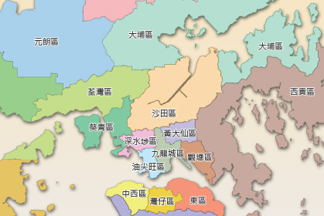
36 participating RCHEs
12 RCHEs from Kowloon West District
13 RCHEs from Kowloon East District
11 RCHEs from Kowloon Central District

Slide 35

“…Death must be so beautiful. To lie in the soft brown earth, with the grasses waving above one's head, and listen to silence. To have no yesterday, and no to-morrow. To forget time, to forget life, to be at peace… “ Oscar Wilde,1887

Slide 36

Acknowledgement
  Hong Kong Jockey Club Charities Trust
  Participated RCHEs and their staff
  Residents and their family members
  HKAG End-of-Life care team

Slide 37

香港老年學會
Hong Kong Association of Gerontology

